Slide 1


E-COMMERCE DASHBOARD ANALYSIS
Data Insights for Smarter
Business Decisions
Presented By:
Kilanko Racheal Abimbola
Tools used: Power BI, Excel, Flaticon & Microsoft PowerPoint

Slide 2

BUSINESS PROBLEM
The Company wants to understand:
Sales performance
Customer behavior
Product trends
Payment Categories

Slide 3
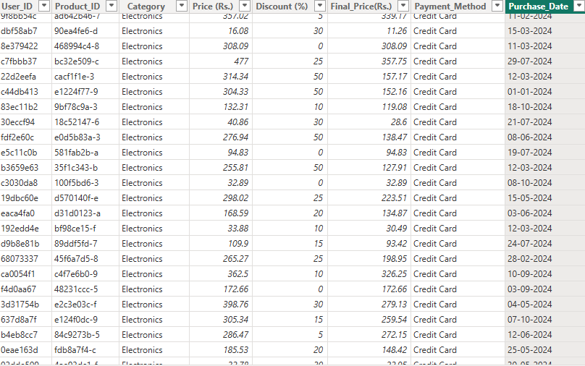
DATASET OVERVIEW
Source: Kaggle - E-commerce Dataset
Rows: 3,660
Columns: 8
Time Period: Jan 2024- Nov 2024
Cleaning: Removed Duplicates ,
Null values, and format text and date

Slide 4
KPI SUMMARY
Total Price
757,000
Total Customer
4,ooo
Total Discount
69,000
Total Category
7

Slide 5
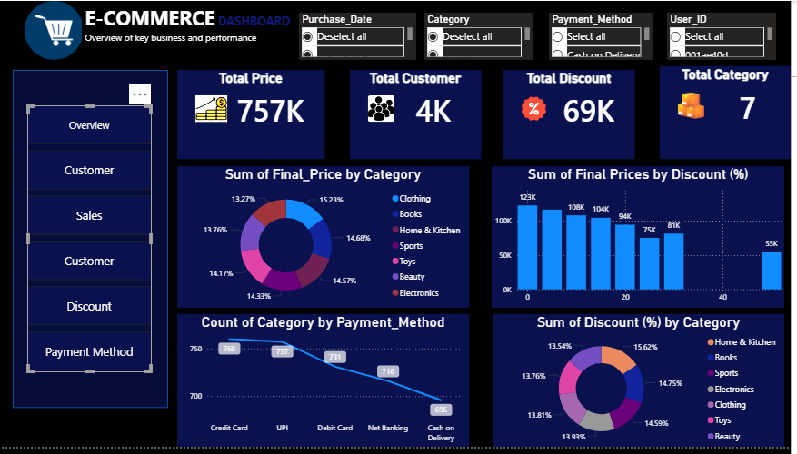
DASHBOARD OVERVIEW

Slide 6
KEY INSIGHT
Category (Clothing) generated highest Sales
Credit Card was most used in payment method
Category (Home & Kitchen) used the highest discount

Slide 7
CONCLUSION
The dashboard provides actionable insights that support strategic business decisions, improve profitability, and enhance customer satifaction.

